Slide 1
„B&G Display study 2023“ Retailer Interviews S Secondary Placements in Grocery
Retailer Results
September 2023

Slide 2
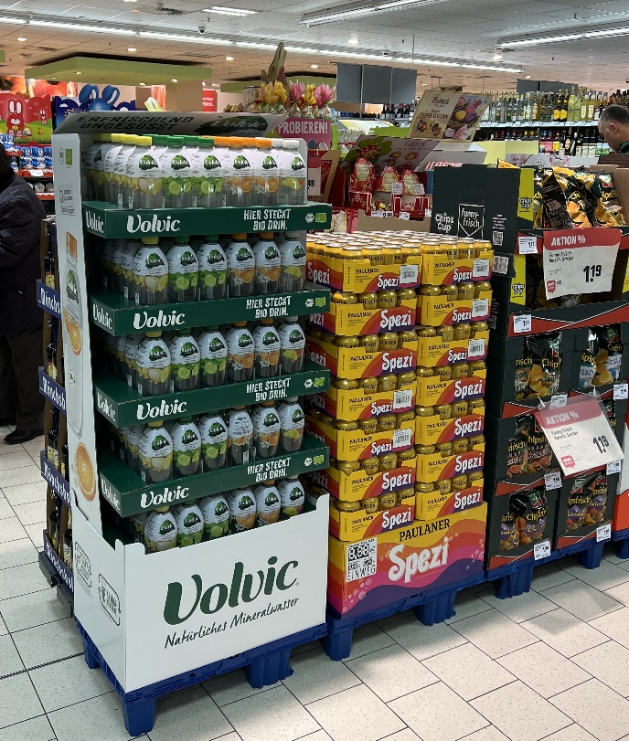
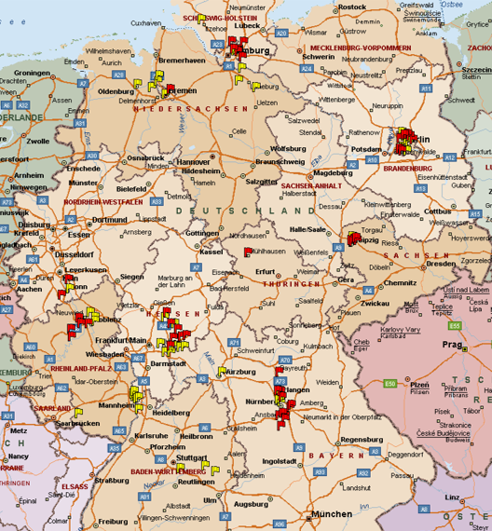
Retailer survey „Edeka & REWE“
Approach
Methode: Face-To-Face interviews with decision makers in retail
Owner 30%,
Store Manager 51%
Department Manager 19%
Focus: Secondary placements from a retailer pov
Timing: July / August 2023
Sample: n=100 Stores Edeka 51% vs. REWE 49% VMG 26% vs VMK 74%
Questions:
Importance of various types of secondary placements for the retailer
Significance of agreements for secondary placements
Criteria for allocating secondary placement spaces
Preferences for display content
Aspects for display decision-making in retail
Evaluation of the sustainability vs. attractive advertising materials conflict
Importance of displays for selected categories including reasoning
Manufacturers/brands with the most attractive displays/secondary placements
Relevance of national activation vs. Key Innovation Points (KIP

Slide 3
02
Results
„Retailer survey
secondary placement“

Slide 4

Secondary placements/industry displays more important than pallets and store furniture; enduring secondary placements also relevant
In your opinion, how important are the following types of secondary placements for your market? (On a scale of 1 to 5, where 1 means 'unimportant' and 5 means 'very important')
% of respondents answering 5 or 4
SP in general
Industry displays
Pallets
Own store furniture
Enduring SP
Display with
Standee for in-store contest/game
Display (DP) with
Standee for in-store purchase incentive
n=100 Edeka n= 51; REWE n=49 VMG n=26; VMK n=74

Slide 5
Retailers already tapping into secondary placement potential effectively - from their own perspective
'Do you think you have effectively utilized the potential of secondary placements in your market so far? % of respondents answering with “yes”
Total
Edeka
REWE
VMG
VMK
n=100 Edeka n= 51; REWE n=49 VMG n=26; VMK n=74

Slide 6
Industry agreements take priority – Headquarter has little influence
'What importance do the following agreements have for secondary placements in your market? (On a scale of 1 to 5, where 1 means 'no importance' and 5 means 'very high importance')
% of respondents answering with 5 or 4
Display allocation through retailer HQ
Display reco through retailer HQ
Bilateral agreement with manufacturer
Annual agreement with manufacturer
Talon activities / ad hoc
n=100 Edeka n= 51; REWE n=49 VMG n=26; VMK n=74

Slide 7
Sales & revenue are top criteria
How important are the following criteria for the decision for a specific secondary placement in your market overall? (On a scale of 1 to 5, where 1 means 'unimportant' and 5 means 'very important')
% of respondents answering with 5 or 4
High sales potential
Profitability of items
Good field sales contact
Appearance/attractive design
Leaflet advertising
Seasonality
Ensuring product availability
New products / profiling
Manufacturer's trade discount
Others
n=100 Edeka n= 51; REWE n=49 VMG n=26; VMK n=74

Slide 8
Simple stocking after promotion (leftovers) and simple-set up are the key decision criteria for a display
How important are the following aspects for your display decision? (On a scale of 1 to 5, where 1 means 'unimportant' and 5 means 'very important)
1 not important
2
3
4
5 very important
Simple stocking (shelf) after promotion
Simple set-up (ready to sell)
Attractive appearance,
even when halfway sold out
Attractive design / Eye catcher
2%
Selling within 2 weeks
Selling within 1 week
Max. Display height of 1,6m
Consumer relevant topic
2%
n=100 Edeka n= 51; REWE n=49 VMG n=26; VMK n=74

Slide 9
Sustainability is important, but decoration is more important (except for VMG); Paper is the preferred material
What is more important for you concerning display material (sustainability vs attractive design and plastic vs paper)?
Sustainability vs attractive design
preference
Ideal material for display
Sustainablity
Plastic
Attractive design
Paper
Gesamt
Gesamt
Edeka
Edeka
REWE
REWE
VMG
VMG
VMK
VMK
Combination of both; cardboard for temporary displays and wood for enduring placements. Functionality/stability is important. Reusable standees
n=100 Edeka n= 51; REWE n=49 VMG n=26; VMK n=74

Slide 10
Overfill after Price Off at Nr. 2; Multibuy (VMK), add-ons at REWE, other mechanisms 'weaker' (raffle, coupon)
'How well, in your opinion, do the following promotion mechanisms suit the placement of a display? (On a scale of 1 to 5, where 1 means 'poor' and 5 means 'excellent')
Gesamt
Edeka
REWE
Price off
Overfill
Multibuy
% of respondents answering with 5 or 4
Additional product
Retailer exclusive product
Raffle
Voucher
n=100
Edeka n= 51; REWE n=49 VMG n=26; VMK n=74

Slide 11

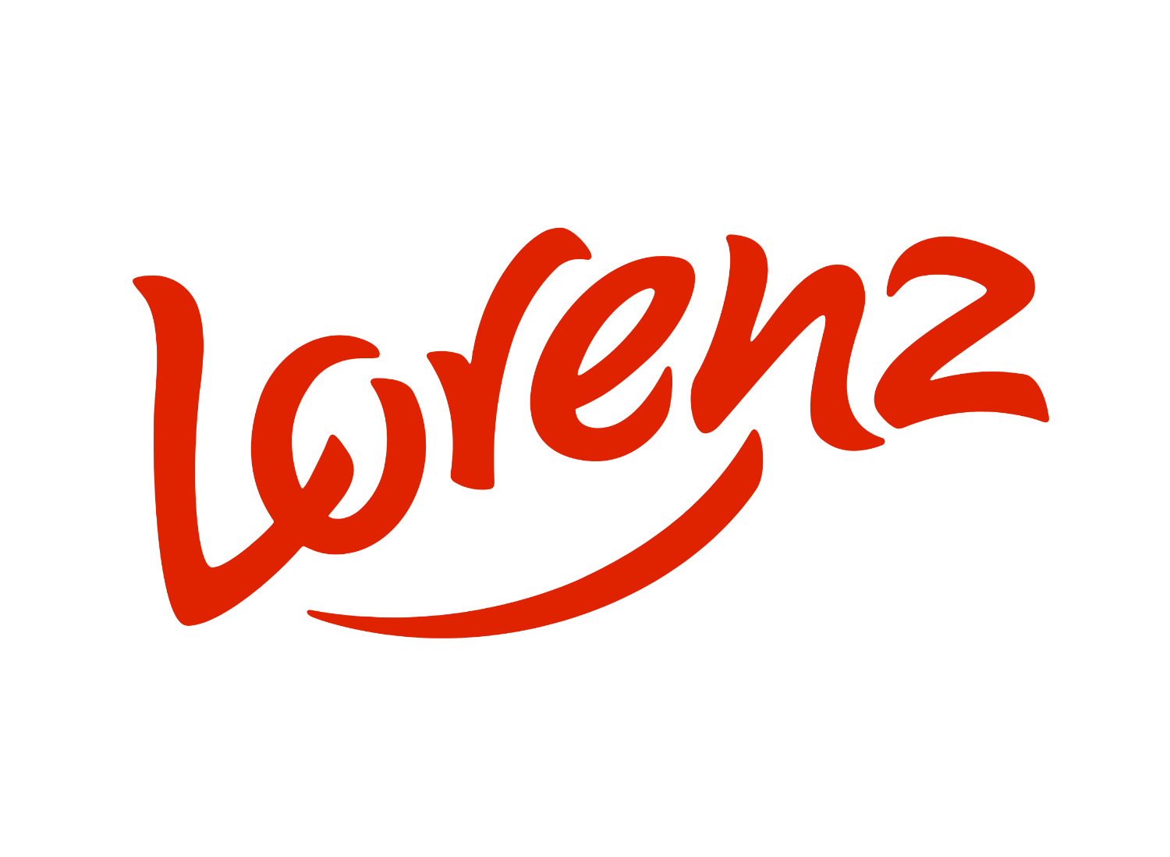

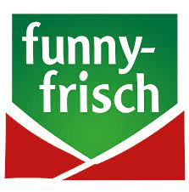

TOP: Red Bull, Lorenz, Coca-Cola, as well as Funny Frisch and Lindt, are the most attractive secondary placements.
Most attractive secondary placements from retailer perspective
Top brands (open answers)
Top 5 Marken Erläuterungen
Red Bull
Highly visible, easy for both the customer and us, quick sales, ample stock, good margin, and appealing placement
Lorenz
Coca-Cola
Simple setup, quick shelving, good margin, proper stocking, effective advertising materials, sometimes smaller displays, fast sell-through
Funny Frisch
Lindt
Eye-catching with red color, popular products, high sales, good impulse buying, sometimes attractive setups with lighting.
Desperados
Profitable, self-sustaining, fast sell-through, appealing setups, often supplemented with extras like contests
Milka
Niederegger
Attractive display placements, high-quality, prices directly on the products, good margin, service, credits. New products, good displays with special items
Krombacher
Ferrero
n=100 Edeka n= 51; REWE n=49 VMG n=26; VMK n=74
Question: 'In your opinion, which manufacturers/brands have the most attractive displays/secondary placements? (List brands, maximum 5 mentions) including reasoning (open-ended response)'

